Slide 1

NYU TANDON CAREER HUB · FALL 2026
Data Science Bootcamp
Week 7 · Probabilistic models
Instructor: Angelin Ann Jacob
Section 1 · Tue Nov 10
Section 2 · Nov 12
Notes:
Welcome to Week 4. Last week we explored one table with pandas. Real data usually lives in a database, spread across many connected tables, and SQL is how we ask it questions. Today's data: every LEGO set, theme, part and color. Same format as last week: predict, write the query, post in the Zoom chat.

Slide 2
Useful Links
Zoom
Brightspace
GitHub
All sessions are virtual. Use ONLY your NYU SSO Login to be considered for attendance
Assignments, submissions and the discussion board, monitored Monday to Thursday.
Slides and Colab notebooks for every session.
Email
1:1 coaching
datasciencebootcamp@nyu.edu for questions, extensions and attendance approvals.
Optional 30-minute technical interview prep. Book it through Handshake.
Data Science Bootcamp · Fall 2026
2
Notes:
Quick reminder: log in to Zoom with your NYU SSO so attendance counts. Slides and the Colab notebook are on GitHub; the take-home is submitted on Brightspace.

Slide 3


Same song, different genre
THE DATA · DATA STORY 1
ONE ROW PER TRACK
God's Plan
Drake
32,833
labelled
pop
rap
playlist rows
Smells Like Teen Spirit
Nirvana
labelled
pop
rock
28,352
unique songs
460
songs carry more than one genre
Labels made by people are noisy: no model can be 100% right.
danceability · energy · valence · speechiness · tempo · key · genre
Notes:
Raw file: 32,833 rows. A song can appear in several playlists, so we keep one row per track: 28,352 songs. 460 songs carry more than one genre label: God's Plan is both pop and rap, Smells Like Teen Spirit both pop and rock, with nearly identical audio numbers. A genre is just the playlist label a person chose, so no model can be 100% accurate.

Slide 4




Pick a random song: what genre is it?
SECTION 1 · EVENTS AND SAMPLE SPACE
EXPERIMENT
pick a song
OUTCOME
rock
SAMPLE SPACE
all 6 genres
EVENT
rap or r&b
P(GENRE) FOR A RANDOM SONG
adds up to 1.000
0.181
0.190
0.159
0.172
0.152
0.146
pop
rap
rock
latin
r&b
edm
Notes:
Experiment: pick one song at random. Outcome: one result (rock). Sample space: all six genres. Event: a group of outcomes we care about (rap or r&b). With data, a probability is a share: times A happened over total trials. The six genres are about equally common, and the bars add up to 1.

Slide 5
Count the overlap only once
SECTION 1 · PROBABILITY RULES
A: rap
B: danceability ≥ 0.8
ADDITION RULE
0.190 + 0.158 − 0.058 = 0.290
P(A or B) = P(A) + P(B) − P(A and B)
0.132
0.058
0.100
COMPLEMENT
rap 0.19
not rap 1 − 0.19 = 0.81
both
MUTUALLY EXCLUSIVE
rap or rock: no overlap, so just add
Exercise 1 · Probability Basics
Notes:
A = rap, B = danceability >= 0.8. Addition rule: P(A or B) = P(A) + P(B) - P(A and B) = 0.190 + 0.158 - 0.058 = 0.290, which matches counting directly. Complement: P(not rap) = 1 - 0.190 = 0.810. Mutually exclusive events (rap and rock) cannot happen together, so we just add.

Slide 6
Knowing a song is danceable changes the odds
SECTION 2 · CONDITIONAL PROBABILITY
KEEP ONLY THE GIVEN ROW
P(GENRE): ALL SONGS VS. DANCEABLE SONGS
rap
not rap
danceable
≥ 0.8
1,646
2,835
0.37
less
danceable
3,752
20,119
0.19
0.20
0.18
0.17
0.17
0.15
0.15
0.16
0.14
0.10
1,646 / 4,481 = 0.367
0.02
P(rap | danceable) vs. P(rap) = 0.190
pop
rap
rock
latin
r&b
edm
■ all songs ■ danceability ≥ 0.8 (genre colour)
Notes:
P(A | B) = P(A and B) / P(B): keep only the rows where B is true, then find the share where A is also true. Among very danceable songs, 1,646 of 4,481 are rap: 0.367, almost double the 0.190 for all songs. Rap and latin become more likely and rock almost disappears.

Slide 7
Rock is the major-key genre
SECTION 2 · DATA STORY 2
P(MAJOR KEY | GENRE)
- - - all songs 0.57
INDEPENDENCE CHECK
P(A and B) = P(A) × P(B) ?
0.693
rock
0.592
0.562
0.105 actual
0.523
0.522
0.517
0.086 if independent
✗ not independent
latin
0.082 actual
0.083 if independent
✓ nearly independent
pop
rap
rock
latin
r&b
edm
Exercise 2 · Conditional Probability
Notes:
Independent means P(A | B) = P(A), or equivalently P(A and B) = P(A) x P(B). P(major) for all songs is 0.57. Most genres sit near it, so key is nearly independent of genre. Rock: 0.69. The product check fails too: P(major and rock) = 0.1052 vs P(major) x P(rock) = 0.0859, about 22% more than independence predicts.

Slide 8
One playlist, two random variables
SECTION 3 · RANDOM VARIABLES
SONG 1
SONG 2
SONG 3
Take It All Back 2.0
Lone Digger
Dengue Woman Blues
key C
148 BPM
key F
124 BPM
key F
178.3 BPM
X · SONGS IN THE KEY OF C · DISCRETE
T · AVERAGE TEMPO · CONTINUOUS
X = 1
T = 150.11
0
1
2
3
60
200 BPM
separate values with gaps
any value in a range
Exercise 3 · Identify Random Variables
Notes:
Experiment: a playlist of three random songs. X = number of songs in the key of C (discrete: 0, 1, 2 or 3, no 1.5). T = average tempo (continuous: any value in a range). Key numbers 0 to 11 are labels, not amounts, so an average key of 5.4 means nothing. A new playlist gives new values of X and T.

Slide 9
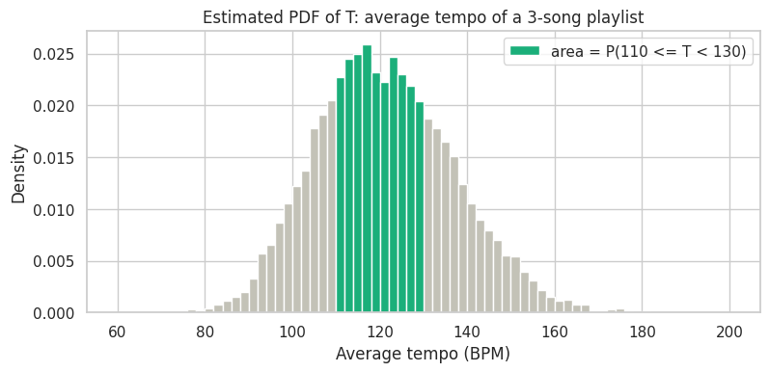
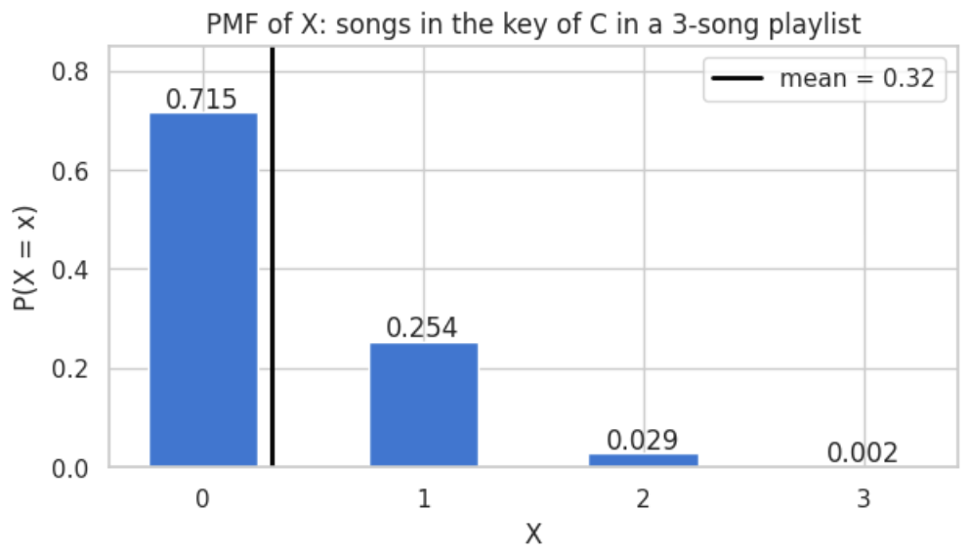
Bars for counts, area for measurements
SECTION 4 · DISTRIBUTIONS: PMF AND PDF
PMF OF X · HEIGHT = PROBABILITY
PDF OF T · AREA = PROBABILITY
bars add up to 1
green area = P(110 ≤ T < 130) = 0.468
Notes:
10,000 random three-song playlists. PMF of X: separate bars that add up to 1; about 72% of playlists have no song in C; mean 0.32 is the long-run average, not a value X can take. PDF of T: probability is area under the curve, not height; the shaded area P(110 <= T < 130) = 0.468, matching the share of playlists. A single exact value has probability 0.

Slide 10
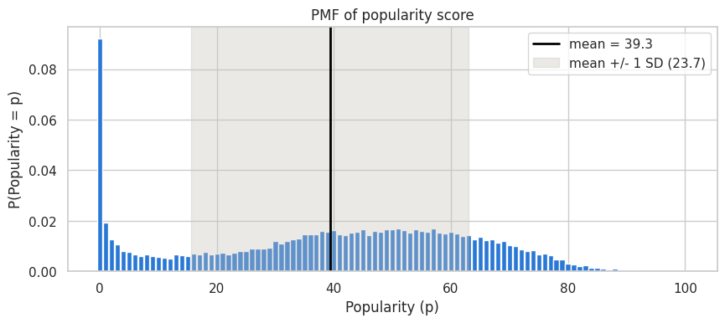
The songs nobody plays
SECTION 4 · DATA STORY 3
PMF OF POPULARITY SCORE
9.2%
of songs score exactly 0
39.3
mean popularity
23.7
standard deviation
Exercise 4 · Distributions
Notes:
Popularity is an integer from 0 to 100, so it is discrete and has a PMF. Mean 39.3, SD 23.7. A broad hump with one odd spike: about 9% of songs have popularity exactly 0. A possible reason (Data Story 1): when a song has several versions, listeners stream one and the others get almost no plays. A hypothesis to investigate, not a proven fact.

Slide 11
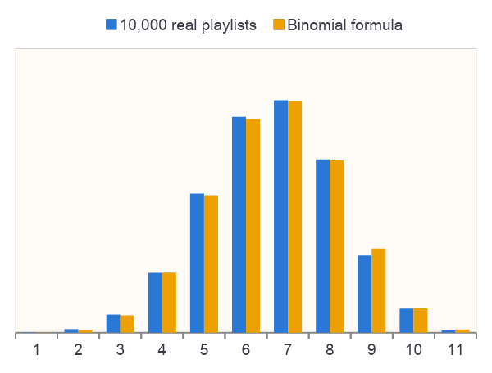
Three ways to count
SECTION 5 · BERNOULLI, BINOMIAL, MULTINOMIAL
BERNOULLI · 1 SONG
BINOMIAL · 10 SONGS
MULTINOMIAL · 12 SONGS
major key?
how many are major?
one random shuffle:
0.566
0.434
pop 1 rap 4 rock 1
latin 3 r&b 1 edm 2
0.0033
0 minor
1 major
chance of exactly 2 of each genre
p = 0.566
P(8 or more major) = 0.118
Exercise 5 · Shuffle Math
Notes:
Bernoulli: one yes/no trial (is a random song in a major key? p = 0.566); mean p, variance p(1-p). Binomial: number of yeses in n independent trials (major-key songs in a 10-song playlist); the formula matches 10,000 simulated playlists; P(N >= 8) = 0.118. Multinomial: counts for several outcomes (genres in a 12-song shuffle). P(exactly 2 of each genre) = 0.0033: random shuffles are lumpy.

Slide 12
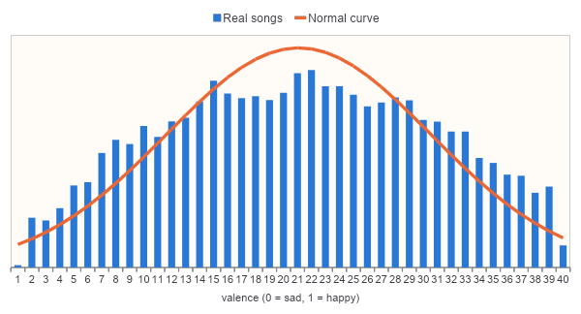
Two numbers draw a bell: μ and σ
SECTION 6 · THE NORMAL DISTRIBUTION
VALENCE OF 28,352 SONGS
μ = 0.51 σ = 0.23
68-95-99.7 RULE
rule real
within 1 SD
68% 62%
within 2 SD
95% 99%
within 3 SD
100% 100%
Z-SCORE · HOW UNUSUAL?
valence 0.9 → z = 1.66
P(> 0.9): model 4.8%, real 4.5%
Notes:
Valence (0 = sad, 1 = happy): mu = 0.51, sigma = 0.234. The bell follows the shape; real data is a bit flatter because valence is stuck between 0 and 1. 68-95-99.7 rule vs real valence: 0.683/0.62, 0.954/0.992, 0.997/1. z = (x - mu) / sigma: valence 0.9 is z = 1.66; P(valence > 0.9) is 0.048 from the model and 0.045 in real songs.

Slide 13
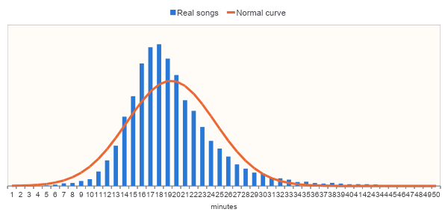
Not every variable is a bell curve
SECTION 6 · DATA STORY 4
SONG LENGTH IN MINUTES
1.12
skewness (0 = symmetric)
8.6 min
longest song
z = 4.8
a bell says: nearly impossible
Exercise 6 · Your Own Bell Curve
Notes:
Song length: most songs last 3 to 4 minutes but a few last 8 or more. Skewness 1.12 (0 means symmetric). The bell is too low at the peak and treats long songs as nearly impossible: the longest song, 8.6 minutes, has z = 4.8. Plot the data before assuming a bell. Gaussian Naive Bayes (Section 9) assumes bell shapes within each genre.

Slide 14
Update a belief with evidence
SECTION 7 · BAYES' THEOREM
POSTERIOR
=
LIKELIHOOD
×
PRIOR
÷
EVIDENCE
0.367
0.305
0.190
0.158
P(rap | danceable)
P(danceable | rap)
P(rap)
P(danceable)
PRIOR · P(GENRE)
LIKELIHOOD · P(SPEECHY | GENRE)
POSTERIOR · P(GENRE | SPEECHY)
0.23
0.60
0.18
0.19
0.17
0.15
0.15
0.16
→
→
0.08
0.18
0.04
0.03
0.09
0.02
0.01
0.06
0.01
0.06
pop
rap
rock
latin
r&b
edm
pop
rap
rock
latin
r&b
edm
pop
rap
rock
latin
r&b
edm
Notes:
Prior: belief before the evidence. Likelihood: how likely the evidence is if the hypothesis is true. Evidence: how common the evidence is overall. Posterior: belief after the evidence. Hypothesis: rap. Evidence: danceability >= 0.8. Posterior 0.367 is the same number we counted in Section 2. P(A|B) is not P(B|A): 36.7% of danceable songs are rap; only 30.5% of rap songs are danceable. Bottom: evidence = speechiness > 0.3. For each genre, prior x likelihood, then divide by the total.

Slide 15
The base rate trap
SECTION 7 · DATA STORY 5
100 HIGH-ENERGY SONGS (ENERGY > 0.9)
BEFORE: PRIOR
■ edm 38
0.172
■ rock 28
■ pop 14
P(edm), any song
■ latin 9
■ rap 7
■ r&b 4
AFTER: POSTERIOR
0.387
P(edm | energy > 0.9): still under 40%
Exercise 7 · Bayes on Spotify
Notes:
Claim: a song with energy above 0.9 is probably EDM. Prior P(edm) = 0.172. Likelihood P(high energy | edm) = 0.306, versus 0.136 for all songs. Posterior P(edm | high energy) = 0.387: 1,492 of 3,855 high-energy songs. EDM is more likely, but still below 40%, because rock is energetic too. Ignoring the base rate is the base rate fallacy.

Slide 16
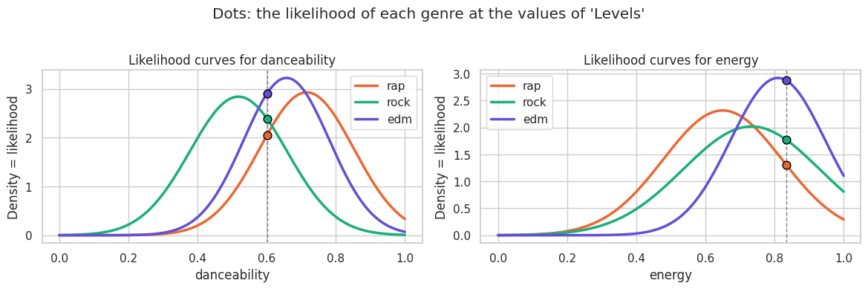
Multiply the evidence, one feature at a time
SECTION 8 · NAIVE BAYES
P(genre | song) ∝ P(genre) × P(danceability | genre) × P(energy | genre)
DANCEABILITY · LEVELS = 0.601
LEVELS · AVICII · BY HAND
prior
× dance
× energy
= score
posterior
0.370
2.05
1.31
0.99
0.20
rap
0.295
2.39
1.77
1.25
0.25
rock
ENERGY · LEVELS = 0.834
0.334
2.90
2.88
2.79
0.56
edm
score ÷ sum of scores = posterior
Notes:
Classifier: P(genre | features) is proportional to P(genre) x P(features | genre). Naive assumption: features are independent within each genre, so P(x1, x2 | genre) = P(x1 | genre) x P(x2 | genre). Gaussian NB fits a bell curve per feature per genre; the curve height at the song's value is the likelihood (a density, not a probability). Levels by Avicii: danceability 0.601, energy 0.834. Multiply prior and the two heights, then normalise: EDM 0.55.

Slide 17

Three famous songs, classified by hand
SECTION 8 · DATA STORY 6
Levels
Avicii · labelled edm
Smells Like Teen Spirit
Nirvana · labelled rock
God's Plan
Drake · labelled rap
0.85
0.56
0.46
0.45
0.20
0.25
0.09
0.10
0.05
rap
rock
edm
rap
rock
edm
rap
rock
edm
correct
a close call
correct
Exercise 8 · Classify a Song
Notes:
Only danceability and energy. All three get their labelled genre, with very different confidence. God's Plan is easy: high danceability and low energy are typical of rap. Smells Like Teen Spirit is a close call between rock and EDM: with two features a loud rock song looks like EDM (Exercise 8 adds a feature). scikit-learn's GaussianNB gives the same numbers.

Slide 18



Same recipe, three kinds of input
SECTION 9 · NAIVE BAYES VARIANTS
Test song: I Would Like - R3hab Remix labelled edm
GAUSSIAN NB
numbers
BERNOULLI NB
yes / no flags
MULTINOMIAL NB
word counts
energy
0.76
energy > median
1
like
1
speechiness
0.06
speechiness > median
0
r3hab
1
tempo
139.9
acousticness > median
1
remix
1
POSTERIOR
POSTERIOR
POSTERIOR
rap
0.04
rap
0.11
rap
0.00
rock
0.05
rock
0.07
rock
0.00
edm
0.92
edm
0.82
edm
1.00
Notes:
The recipe is always prior x product of likelihoods; only the likelihood's distribution changes. fit learns priors and likelihoods, predict_proba scores and normalises, predict picks the top genre. One held-out test song, I Would Like - R3hab Remix (labelled edm), through all three. Gaussian: real numbers, a bell curve per genre and feature. Bernoulli: yes/no flags, "above the training median?". Multinomial: word counts from the title.

Slide 19
All three beat the baseline; Gaussian wins
SECTION 9 · TEST ACCURACY
TEST ACCURACY · RAP, ROCK, EDM
GAUSSIAN NB · CONFUSION MATRIX
predicted →
rap
rock
edm
0.73
rap
0.71
0.11
0.18
0.64
0.63
rock
0.07
0.68
0.25
0.37
edm
0.09
0.10
0.80
baseline
Gaussian
Bernoulli
Multinomial
rows: actual genre
Notes:
Train on 75% of the 14,580 rap, rock and EDM songs, test on the 25% never seen. Baseline always guesses the most common genre: 0.37. Gaussian NB 0.73, Bernoulli NB 0.637 (yes/no flags throw away detail), Multinomial NB 0.631 from titles alone. Confusion matrix rows are the actual genre: rock is most often mistaken for EDM (0.25), since both can be high-energy.

Slide 20
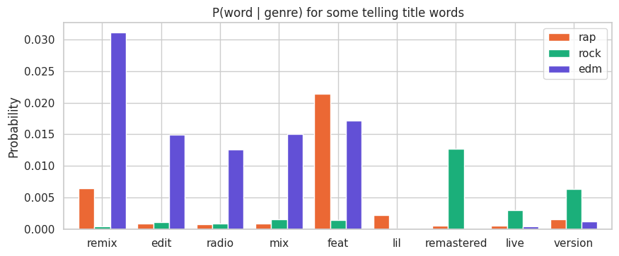
Song titles give the genre away
SECTION 9 · DATA STORY 7
P(WORD | GENRE) IN TRAINING TITLES
SMOOTHING
'remastered' in training titles
rock
239
rap
9
edm
0
0 × anything = 0
One unseen word would rule out EDM. Laplace smoothing adds 1 to every count.
Exercise 9 · Your Own Classifier
Notes:
Multinomial NB on title words alone (vocabulary 8,425 words) scores 0.631. EDM titles are full of remix, edit, radio, mix. Rap titles have feat and lil. Rock titles have remastered, live, version, from re-released classics. The model learns how each genre names its releases, not the music. Smoothing: 'remastered' never appears in an EDM training title; a zero probability would wipe out EDM. Laplace smoothing adds alpha = 1 to every count.

Slide 21






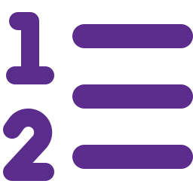




Eleven ideas from today
SUMMARY
Probability
Rules
Conditional
Independence
Random variables
PMF vs. PDF
a share of outcomes
count overlaps once
restrict to the given group
P(A | B) = P(A)
discrete or continuous
height vs. area
OUR DATA
0.73
Gaussian NB vs. 0.37 baseline
460
songs with two genres
Counting
Normal
Bayes
Naive Bayes
Variants
Bernoulli, Binomial, Multinomial
μ, σ, z-scores
prior × likelihood ÷ evidence
multiply per-feature likelihoods
numbers, flags, word counts
Notes:
Recap of the probability building blocks and how Naive Bayes puts them together. Data lesson: genre labels are playlist labels chosen by people, so they are noisy.

